Slide 1

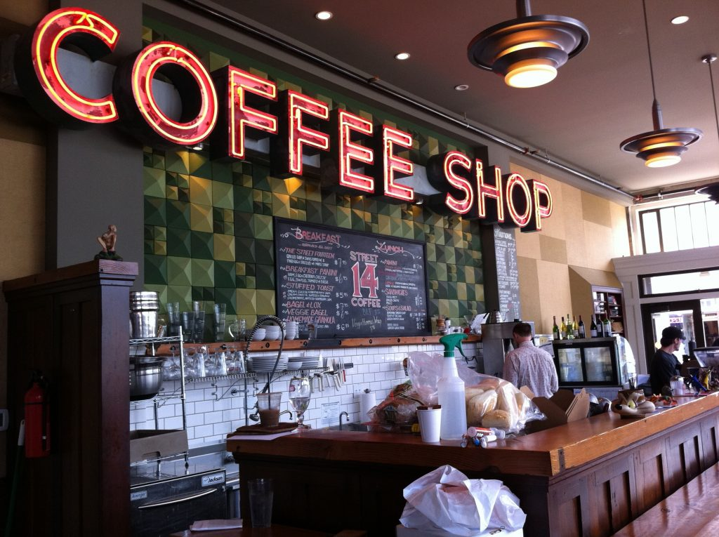
Analysis of Reviews for Cafes in NYC
Instructor: Prof. Rong (Emily) Liu
Course: BIA-660-B
Group 10
Team Members:
Vaibhav Shanbhag
Krishma Shah
Sukit Kajonpradapkul
Jui Pendharkar

Slide 2

Contents
Introduction
Web Scraping
Data Processing
Exploratory Data Analysis (EDA)
Analytics models for text
Applications
Conclusion & Future Work

Slide 3
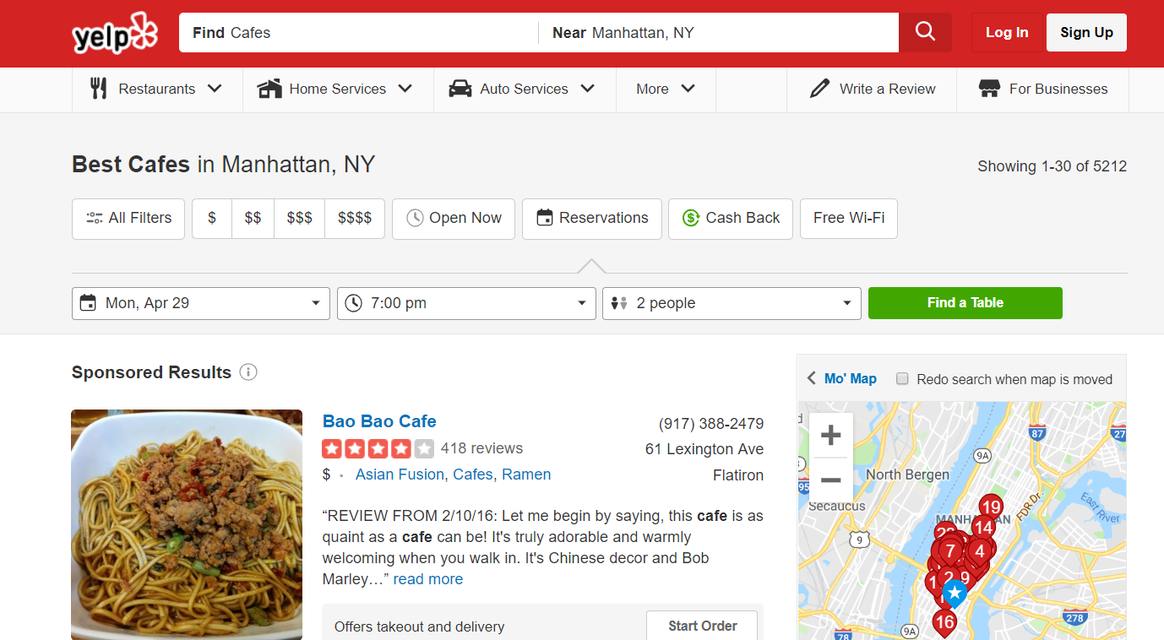
Introduction
Online reviews and customer feedback can give businesses great insight in order to improve their business model.
Our goal is to analyse the reviews for Coffee shops and Cafes in Manhattan,NY and develop methods to extract business intellect from reviews, to understand what factors cause customers to be satisfied or dissatisfied.This can help them to improve customer satisfaction and their profit.
Method: Develop models to extract all the reviews of cafes and determine the sentiment of the review and classify all the features that affect the review in our dataset.
Differentiate and compare the performance between all the models.

Slide 4
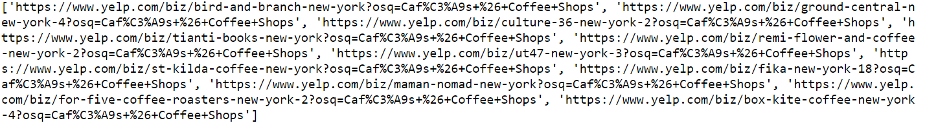
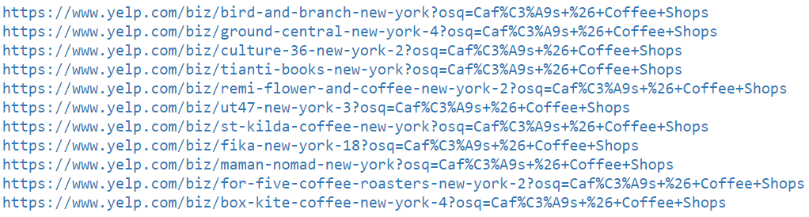
Web scraping
Firstly, we extracted the links of the cafes and stored it into a list from the list of cafes on Yelp website.
The Selenium package was used to scrape this links

Slide 5
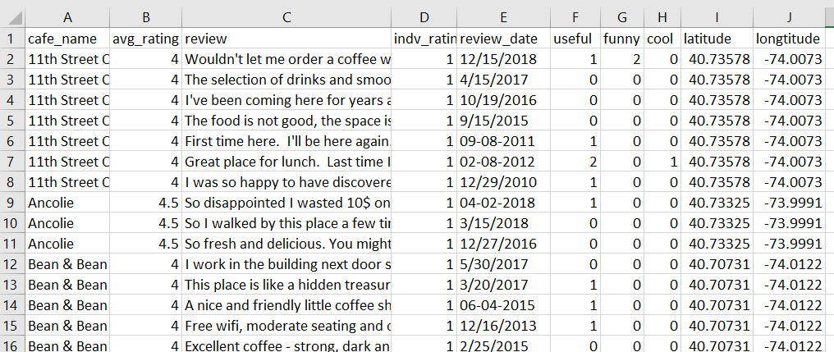
Web scraping
Minimum of 10 constraints and 10269 reviews were considered to scrape the data of cafes from the list of links for our analysis.
Selenium was used to scrape the data and store it into a .CSV format file.

Slide 6
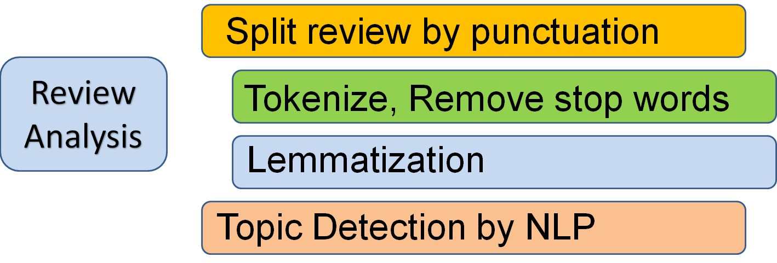
Data Processing
We polarised the dataset into highly positive (star rating = 4,5) and highly negative (star rating = 1,2).
These reviews were classified into 2 main categories as positive and negative reviews.
Further, review analysis was performed on the processed data to get the tokens to determine the sentiment and topics.
Top Frequent Tokens are:

Slide 7
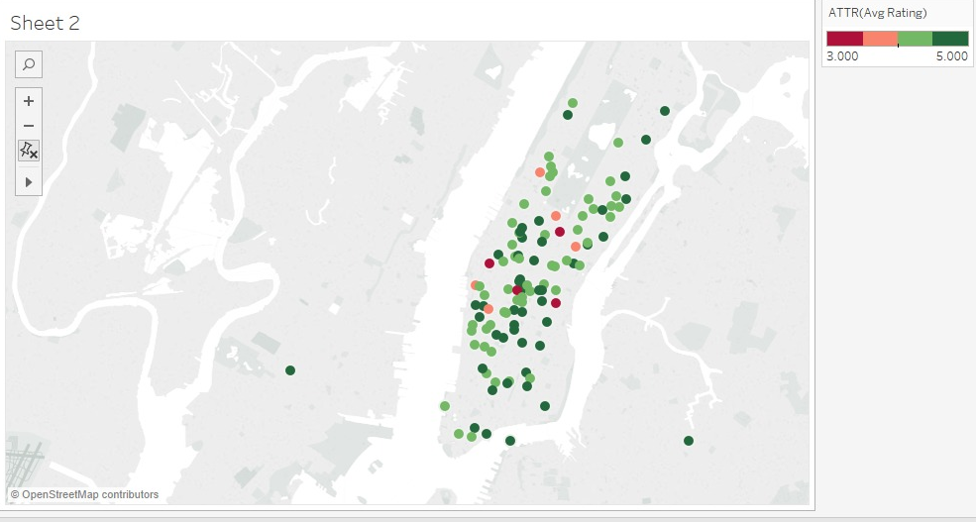
Exploratory Data Analysis (EDA)
Analysis of cafes and ratings
We used tableau to locate the cafes and coffee shops across Manhattan to get an overview of the type of cafes in terms of their star ratings.
From the graph, it can be concluded that the Midtown area of Manhattan has a lot of 4.5 and 5 star rating cafes

Slide 8
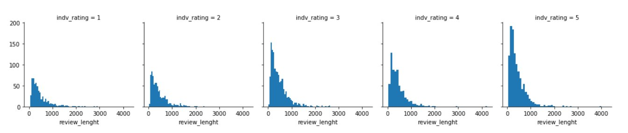
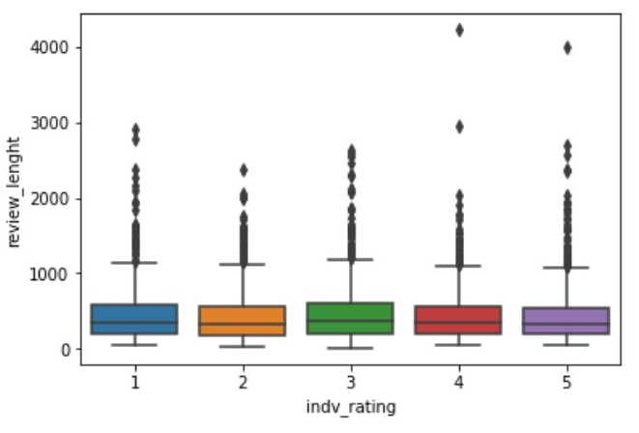
Exploratory Data Analysis (EDA)
Analysis of Review length
The graphs depicts the distribution of review length is almost the same along all the star ratings.
The individual star ratings does not actually affect the length of the review and review length is not much of a crucial factor to study for this dataset.

Slide 9
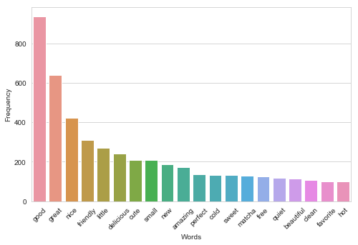
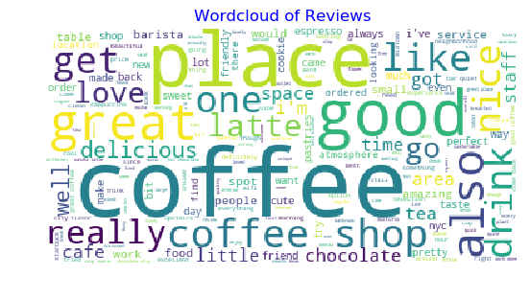
Exploratory Data Analysis (EDA)
Analysis of tokens
Top 20 tokens before lemmatization
Top 20 tokens after lemmatization
Top common tokens: good, great, nice, delicious.
The top tokens that occur before lemmatization consists of coffee, place, shop, really, get, etc. which are not important for our analysis and so we only focussed on adjectives tokens using lemmatization and POS tag.

Slide 10
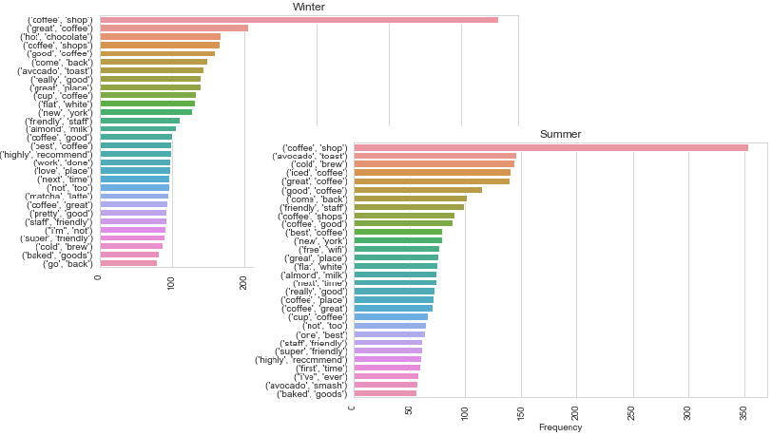
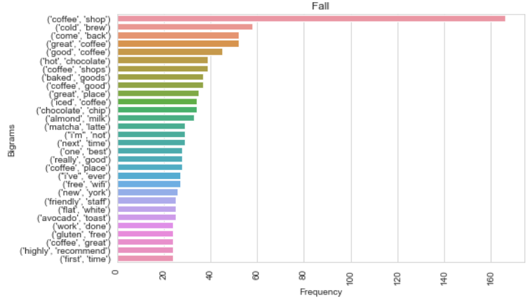
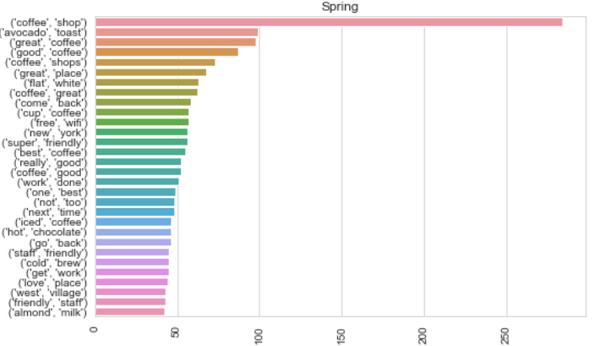
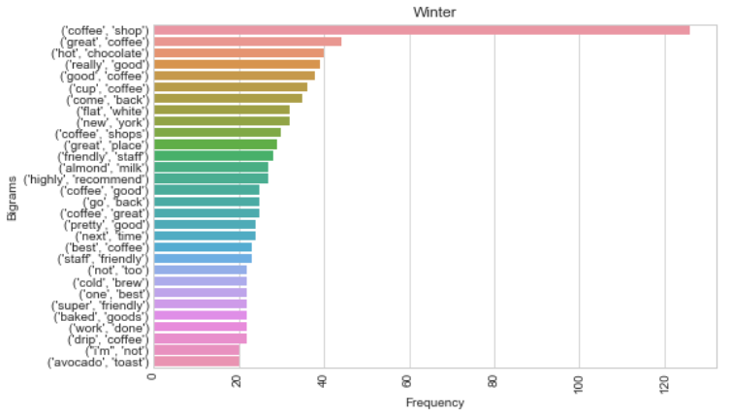
Exploratory Data Analysis (EDA)
Avocado toast
Iced coffee
Hot chocolate

Slide 11
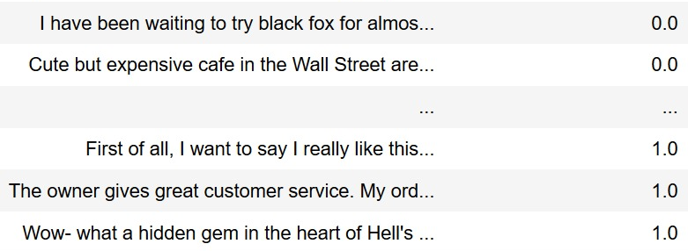
Text Analytics Models
Sentiment Analysis
Sentiment Analysis, also known as opinion mining, is the process of determining whether a text unit is positive or negative.
We have used two approaches:
Multinomial Naive Bayes (NB) Model
Support Vector Machine (SVM) Model
Training dataset for sentiment analysis

Slide 12
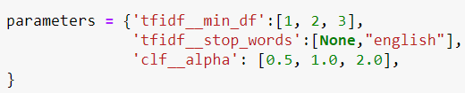
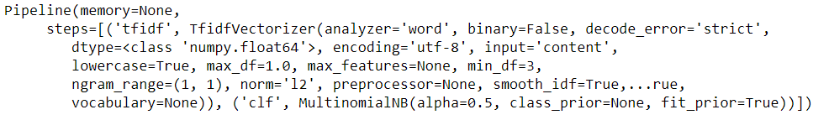
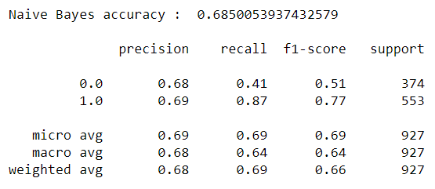
Sentiment Analysis using Naive Bayes
Classification report for Naive Bayes Model

Slide 13
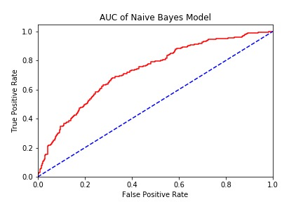
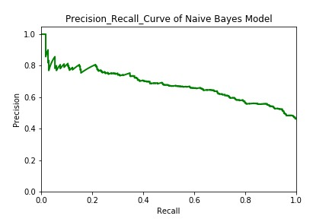
Naive Bayes Model
AUC and Precision-Recall curve

Slide 14
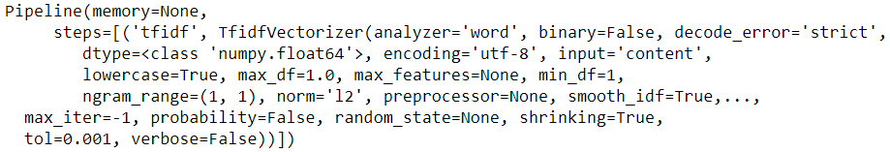
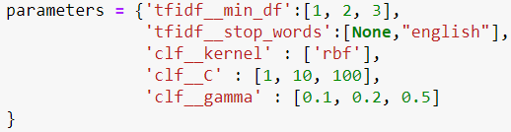
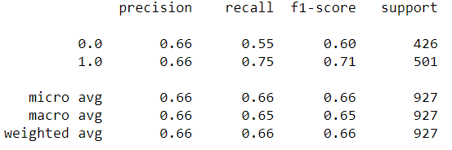
Sentiment Analysis using SVM Model
Classification report for SVM Model
Accuracy for Naive bayes is more than SVM Model for sentiment analysis by the observations.
For our dataset, Naive bayes proves to be a better model for predicting the sentiment.

Slide 15
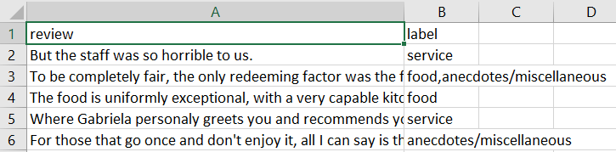
Text Analytics Models
Topic Classification - Supervised Learning
Topic classification provides method to classify documents into categories.
External dataset was used to train models. The topics are ambience, food/coffee, price, service, anecdotes/miscellaneous
One-vs-rest classification.
Three techniques are evaluated including:
K-Nearest neighbors (KNN) Model
Multinomial Naive Bayes (NB) Model
Support Vector Machine (SVM) Model
Source- http://metashare.ilsp.gr:8080/repository

Slide 16
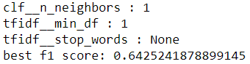
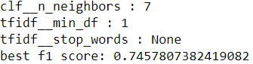
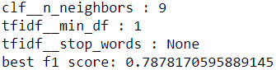
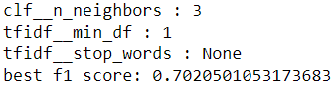
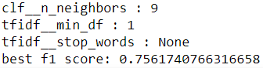
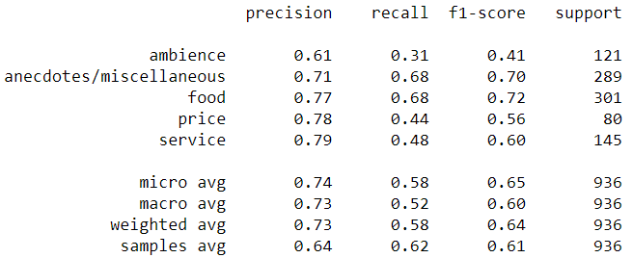
Topic Modeling using KNN(Tuning K=1 to 10)
Topic : ambience
Topic : anecdotes/miscellaneous
Topic : food/coffee
Topic : price
Topic : service
Classification report for KNN Model

Slide 17
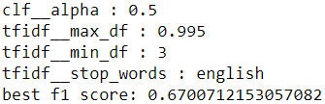
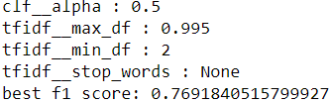
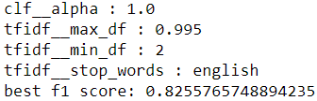
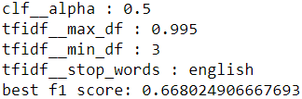
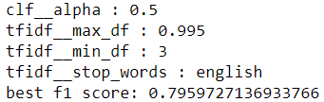
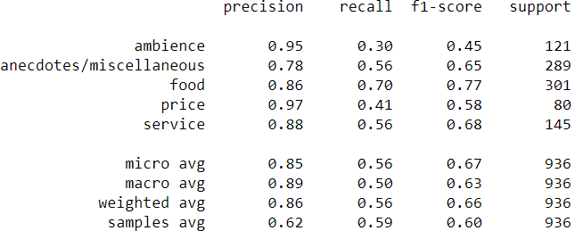
Topic Modeling using Naive Bayes
Alpha = [0.5, 1.0, 2.0, 5.0]
Topic : ambience
Topic : anecdotes/miscellaneous
Topic : food/coffee
Topic : price
Topic : service
Classification report for Naive Bayes Model

Slide 18
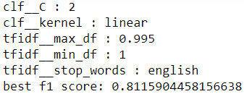
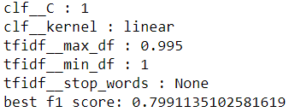
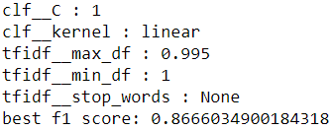
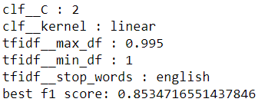
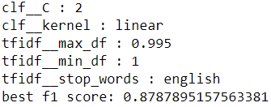
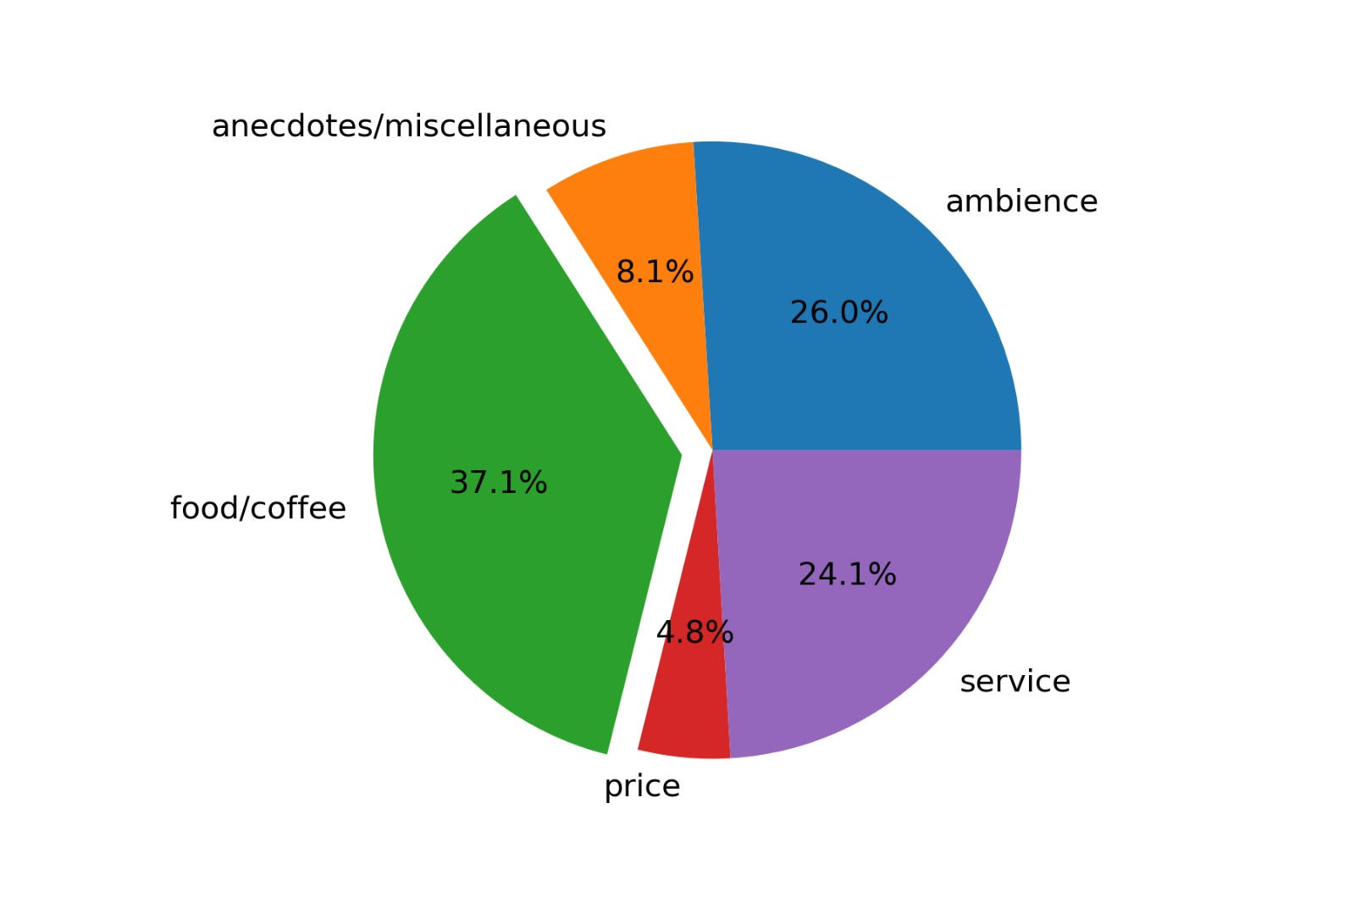
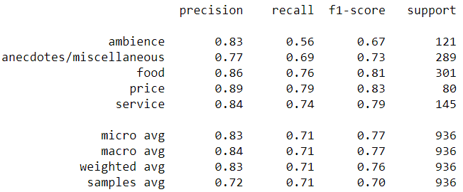
Topic Modeling using SVM Model(Best)
C = [1, 2, 5]
Topic : ambience
Topic : anecdotes/miscellaneous
Topic : food/coffee
Topic : price
Topic : service
Topic Classification
Classification report for SVM Model

Slide 19
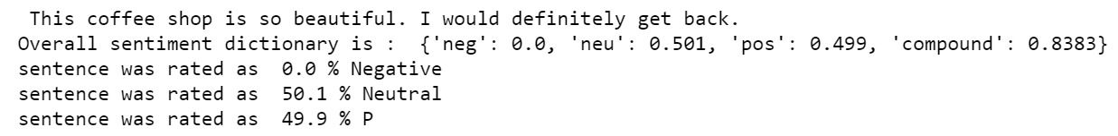
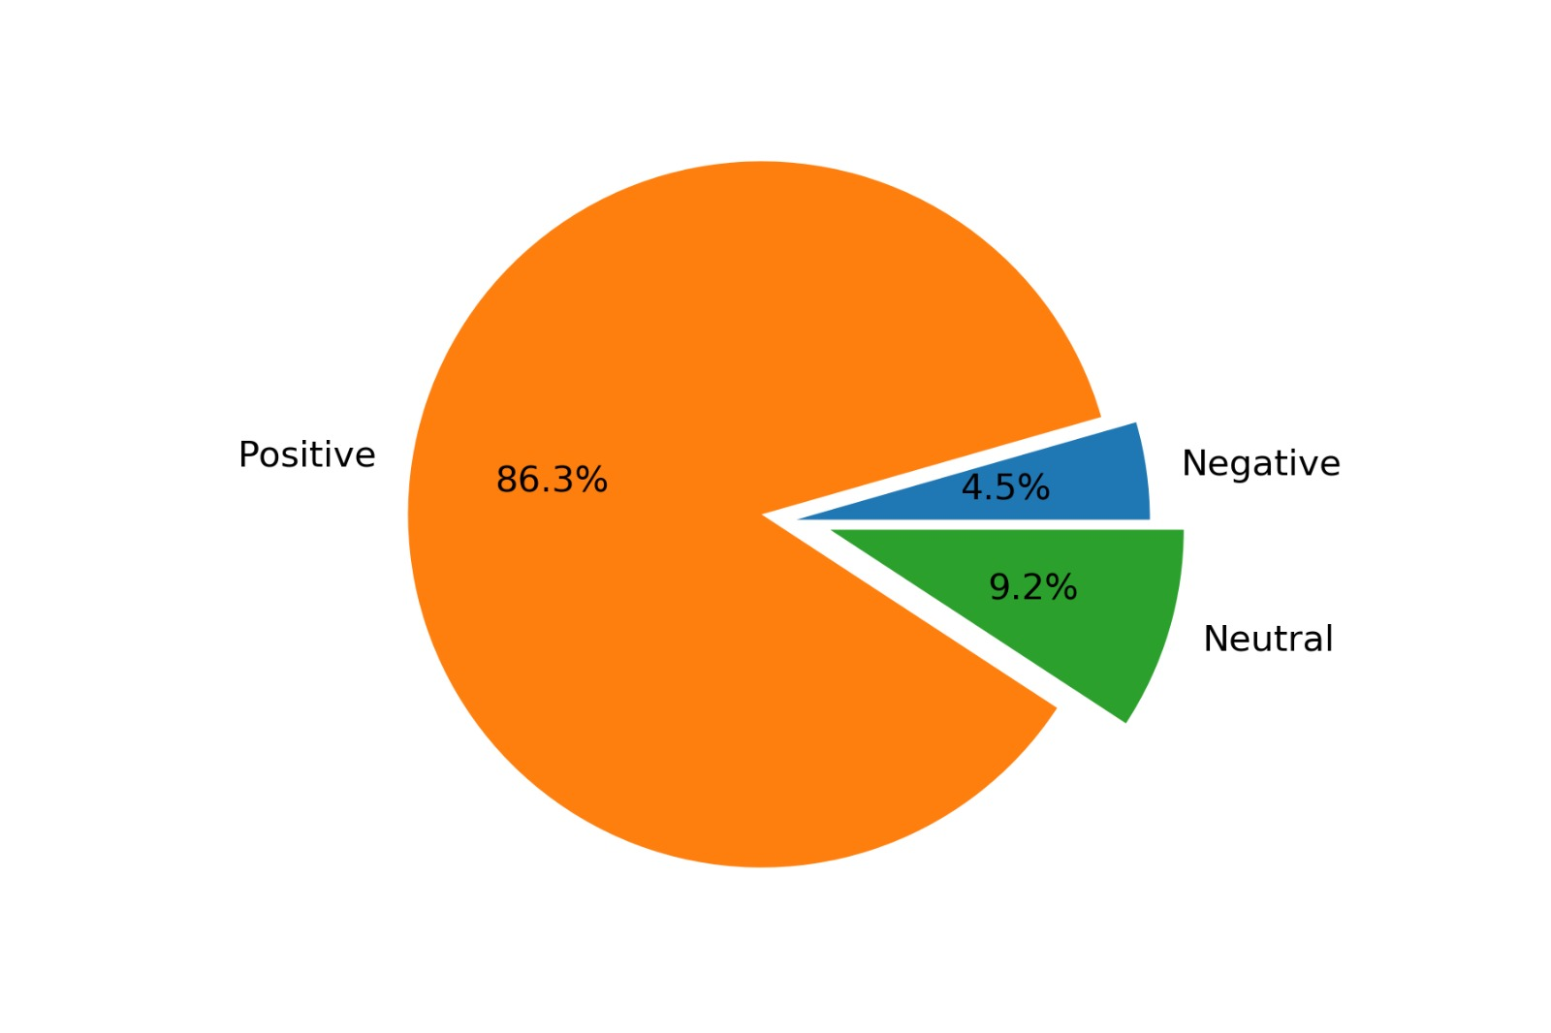
Unsupervised Sentiment Analysis: VADER
Sentiment metrics derived from ratings in Valence-based lexicons
Not just positive Vs negative, sentiment intensity is also considered
Positive, neutral and negative, represent the proportion of the text that falls into those categories.
The final metric, the compound score, is the combination of all of the lexicon ratings which have been standardized to range between -1 and 1 based on some heuristics.

Slide 20
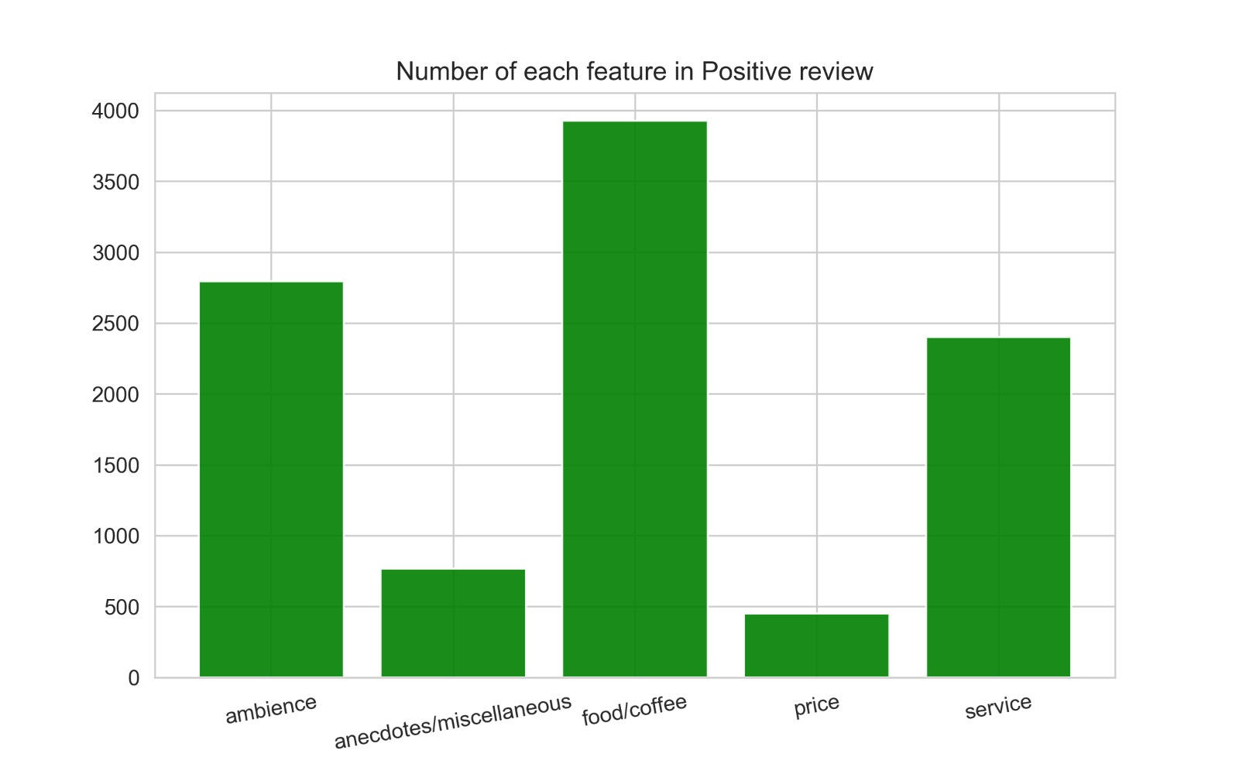
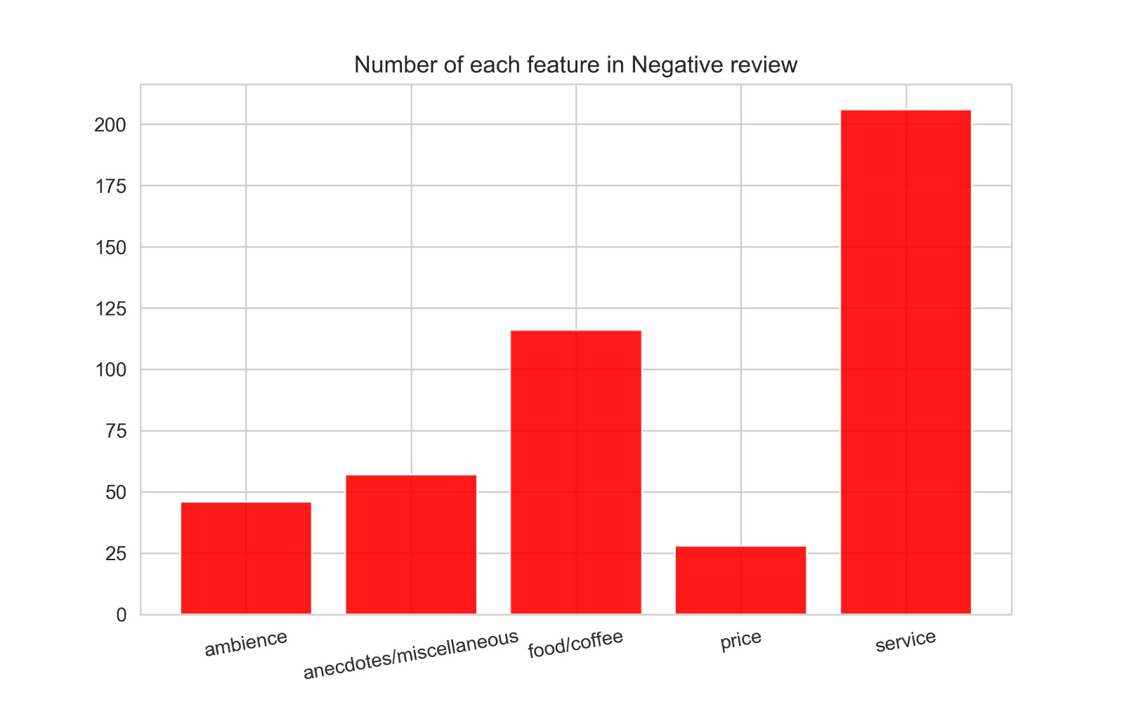
Application
Overall reviews- Vader Sentiment Analysis & SVM
Sentiment for all reviews

Slide 21
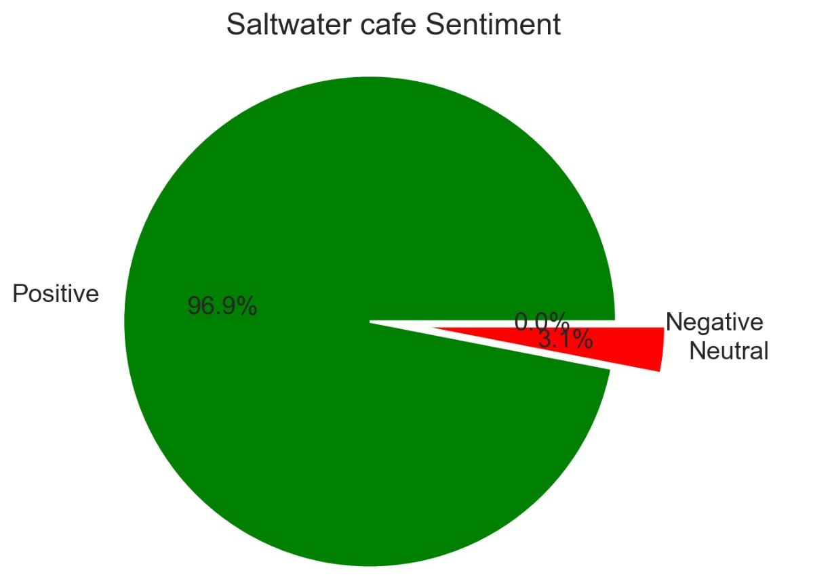
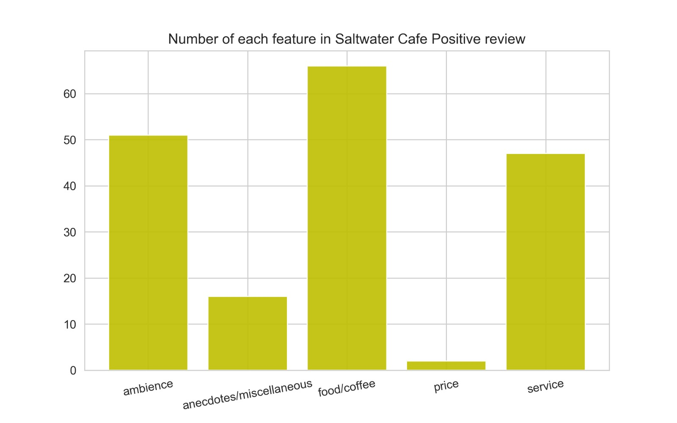
Application
Cafe with 5 star rating- Saltwater Coffee

Slide 22



Application
Cafe with 3.5 star rating- Alice’s Tea Cup Chapter II

Slide 23
Conclusion
Insights
Customers care most about the taste of coffee/food, service, ambience when it comes to cafes. The overall experience matters more to them than the price they pay for the coffee.
Such insights can help cafes improve customer experience along with revenues. Similar analysis can be done for different types of restaurants and regions to gain valuable insights.
Techniques
Sentiment Analysis: Out of Naive Bayes and SVM Model, Naive Bayes gave a better F-1 score (0.69) for our dataset
Topic Classification: Out of KNN, Naive Bayes and SVM, SVM gives a better F-1 score (0.77) for out dataset.

Slide 24

Future Work
Improve the accuracy of our models using neural networks
Study in detail to handle sarcastic comments in reviews
Study the 3 star rating reviews as they can be the most honest reviews and get insights from these reviews
More analysis to help cafes improve the menu based on most popular customer choices

Slide 25

THANK YOU!

Slide 26

Q & A

